Slide 1
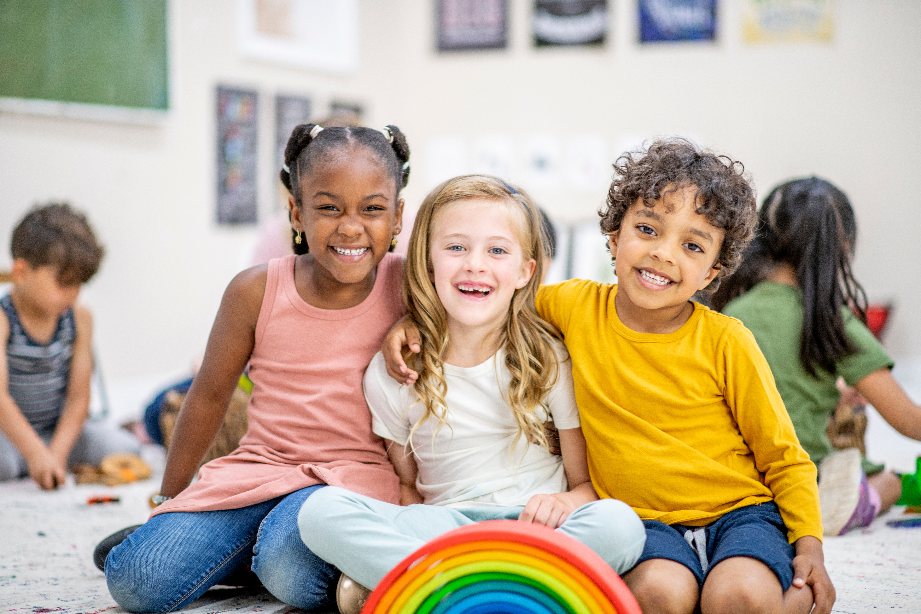



Slide 2
DAY 1
God
loves
all
children

Slide 3
DAY 2
God loves all families

Slide 4
DAY 3
God sends His people to help families in need

Slide 5
DAY 4
God adopts us as His children

Slide 6
DAY 5
People in the church help one another

